Slide 1

The Smart Gardner
Group 27
Green Core
Notes:
Good Morning everyone, we are group no 27. Our project is Green Core - the smart gardner.

Slide 2
Team
G27
Group Members:
M.M.H Tharushika
H.U.K.M Pabasara
J.A.N.C Niroshana
B.A Medawatta
K.C Gamage
K.S.A Ahamed
17001765
17020611
17001196
17001072
17000475
17020034
Supervisor
Dr Dinuni K Fernando
Co-Supervisor
Ms. Sithara Fernando
Notes:
Our group supervisor is Dr. Dinuni K Fernando and Miss. Sithara Fernando is our co supervisor.
And Hashini, Minura, Nipuna, Binara, Kaviska and I Aathil are our group members.

Slide 3

Green Core - The Smart Gardner
G27
Outline
Introduction
Problem Definition
Goal and Objectives
Project Scope
Deliverables
Functional Requirements
Quality Attributes
Feasibility Study
Progress of the project
Member Contribution
High Level System Architecture
Technologies
Deployment Plan
Notes:
This is the outline of the presentation.
I’ll present Introduction and problem definition part.

Slide 4
Problem Definition
G27
People tend to stay at home leisurely for limited time Due to their busy lifestyles.
Gardening with minimum effort is worth and effective.
With the pandemic which occurred in recent past, people tend to grow their own produce for sustainability.
But after this situation people may not have time to take care of their plants due to their busy lifestyle.
Notes:
according to the survey we did among about 160 people,[move to next slide]

Slide 5
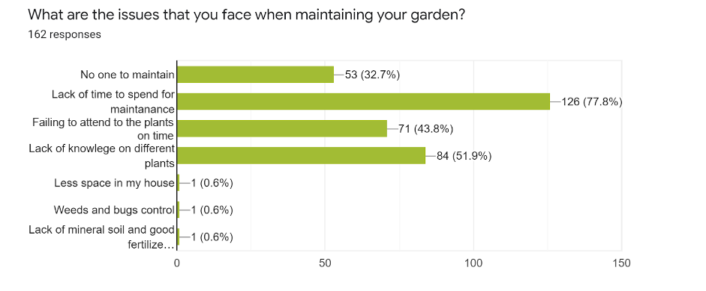
Results of the survey
G27
Notes:
The majority of the people responded that they don’t have that much time for gardening and maintaining the things, and another response was failing to attend to the plants on the time that’s mean due to their busy lifestyle it is very hard to concentrate on the plants. [Move to next slide ]

Slide 6
Problem Definition
G27
People tend to stay at home leisurely for limited time Due to their busy lifestyles.
Gardening with minimum effort is worth and effective.
With the pandemic which occurred in recent past, people tend to grow their own produce for sustainability.
But after this situation people may not have time to take care of their plants due to their busy lifestyle.
Notes:
Usually people tend to stay at home for limited time, due to their busy lifestyle and working schedules. But the pandemic which occured in the recent past, people tend to gardening by themselves for sustainability .
Gardening with minimum effort is worth it.
But after this pandemic, the situation will be totally changed and people may not have time to take care of their gardens as the situations before the pandemic.
We hope “Green Core - The smart gardener” our project will be the suitable solution in these kinds of situations and will be needed.

Slide 7
Introduction
G27
Green-Core is an automated gardening system consists of both manual and automatic gardening features.
Enable users to control their garden while they are away from home by using a smartphone.
Capable of real gardening features such as watering plants.
System consists of an IoT device and a mobile app for the user and a web app to control inner settings.
Notes:
Green core is an automated gardening system.
it consists of both
manual and
2) automatic gardening features,
where Green core enables users of the systems to control the garden it doesn’t matter wherever they are.
And also the system is capable of real gardening features such as
watering plants,
adding fertilizers,
considering growing lights and etc.
Our system consists of IoT device and mobile app for the users.
And a web app for controlling inner settings like admin controls.

Slide 8
Green Core - The Smart Gardner
G27
Outline
Introduction
Problem Definition
Goal and Objectives
Project Scope
Deliverables
Functional Requirements
Quality Attributes
Feasibility Study
Progress of the project
Member Contribution
High Level System Architecture
Technologies
Deployment Plan
Notes:
from here onwards Kavishka will continue
Thank you Athil.[Move to next slide ]

Slide 9

Goal and objectives
G27
Notes:
Now let’s talk about Goal and objectives.[Move to next slide ]

Slide 10
Our Goal
G27
Our main goal is to develop a smart garden environment that allows the user to provide a periodic gardening experience via a mobile phone.
Notes:
To make our project a success we need a clear goal.
Our main goal is to develop a smart garden environment that allows the user to provide a periodic gardening experience via a mobile phone.
Green core - the smart gardener will provide you with a new gardening experience that you never had before.
[Move to next slide ]

Slide 11
Objectives
G27
People can get fresh vegetables and fruits from their garden with aid of a Mobile App.
Track the progress of each unit’s status.
Adjust the growing environment remotely and automatically manage the garden lively.
Get periodic notifications of individual units status via Mobile App.
Administrator can collect, view data of all gardens via Web App and use them for identifying vulnerable units etc.
Notes:
To achieve our goal we have identify our objectives as…
1.People can get fresh vegetables and fruits from their garden with aid of a mobile app.
2.User can Track the progress of each unit's status
3 . user can adjust the growing environment remotely and they can automatically manage the garden lively
4. Get periodic notifications of each unit status via mobile App.
5. with our web app administrator can collect and view data of all the gardens and use them for identifying vulnerable units.
[Move to next slide ]

Slide 12
Project Scope
G27
Notes:
Now let’s talk about project scope.[Move to next slide ]

Slide 13

Project Scope
G27
In Scope
Interactive Mobile App that allows user to control water level, light intensity , liquid fertilizer automatically and manually .
User can monitor soil moisture level, temperature, humidity level using Mobile App.
Web App can identify vulnerable units and interact with users to resolve issues via a chat module.
Notes:
We are developing an interactive Mobile App that allows the user to control water level, light intensity ,liquid fertilizer automatically and manually.
Also user can monitor soil moisture level ,temperature and humidity of the plant bed.
After our proposal defense presentation we have go through our scope and decide to work on only five plants Papaya, Chili, Tomato,Gotukola and das are the selected plants. This will avoid the issue of dealing with huge agriculture domain scope.
And also we are going to track the status of the each plant bed not the individual plant status.
Our Web App can identify vulnerable units and interact with users to resolve those issues.
[Move to next slide ]

Slide 14
Project Scope
G27
Out Scope
Train a machine learning model using the data gathered by the sensors to predict optimal conditions to grow specific plant types.
Generating reports regarding useful analytical data.
Challenges
Bug Control System
Detecting bugs using motion sensors is practically challenging, because even if the motion of leaves are detected the buzzer will switch on.
Notes:
Due to the current time constraints training a machine learning model and generating reports with analytical data is beyond our scope.But if time permits, we hope to develop these features in the future.
We have identified Bug control system as a challenge. Detecting bugs using motion sensors is practically challenging task, because when the motion of the leaves are detected, the buzzer will switch on. So it is not practical at this moment. So we will try to figure out how to control bug system in the future.
[Move to next slide ]

Slide 15
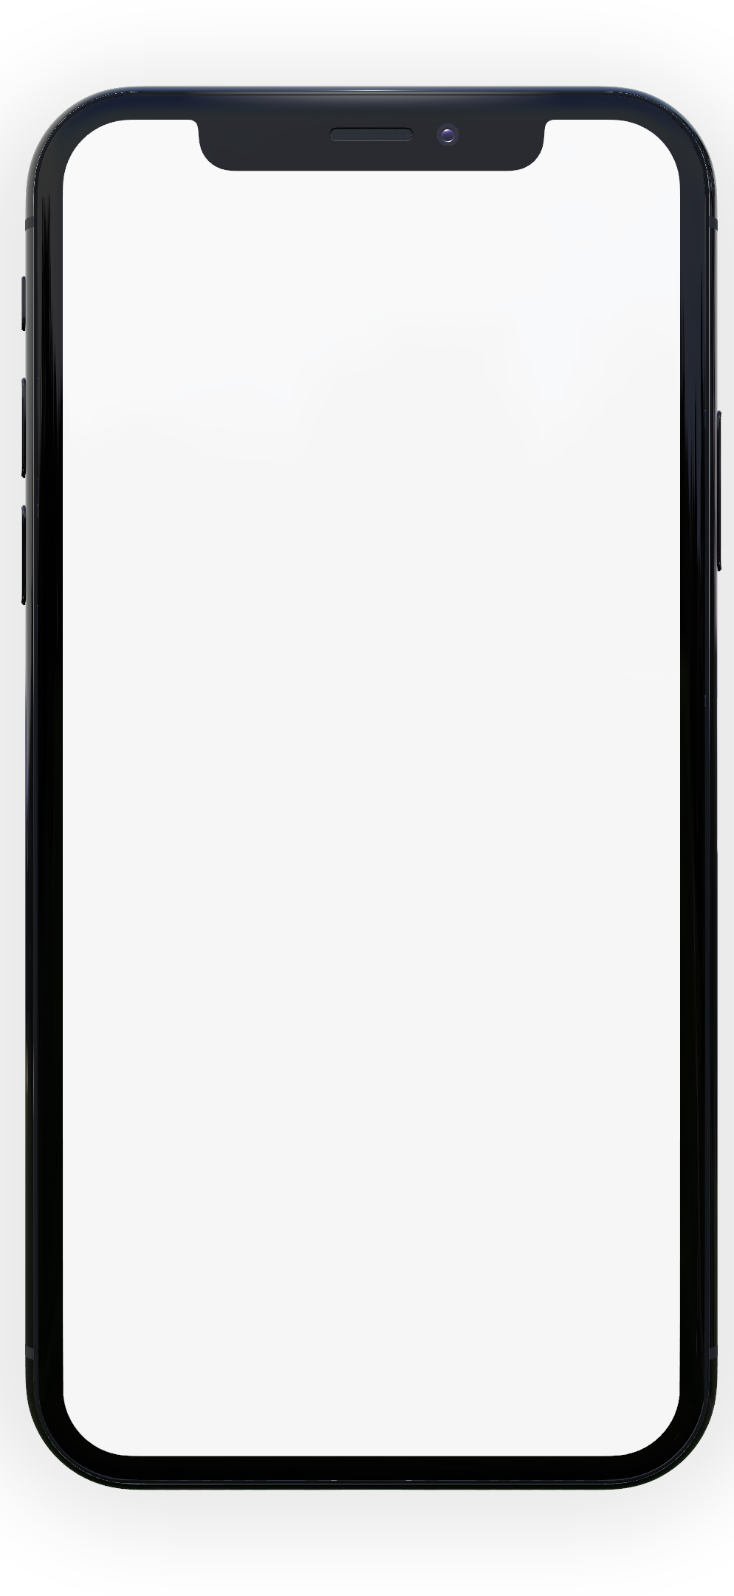
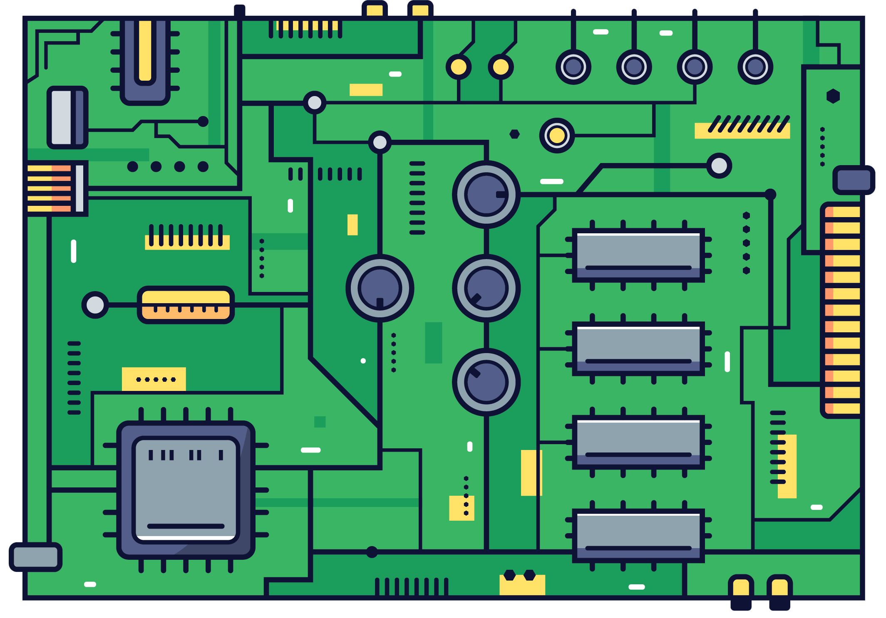

Deliverables
G27
Mobile app
IoT Device
Web App
Notes:
Our main deliverables are , a mobile app that anyone can easily download and install from the playstore ,
an iot device which the user can purchase from the store and a web App for administration purposes.
[Move to next slide ]

Slide 16
Use Case Diagrams
G27
Notes:
Now let’s look at our use case diagrams
[Move to next slide ]

Slide 17
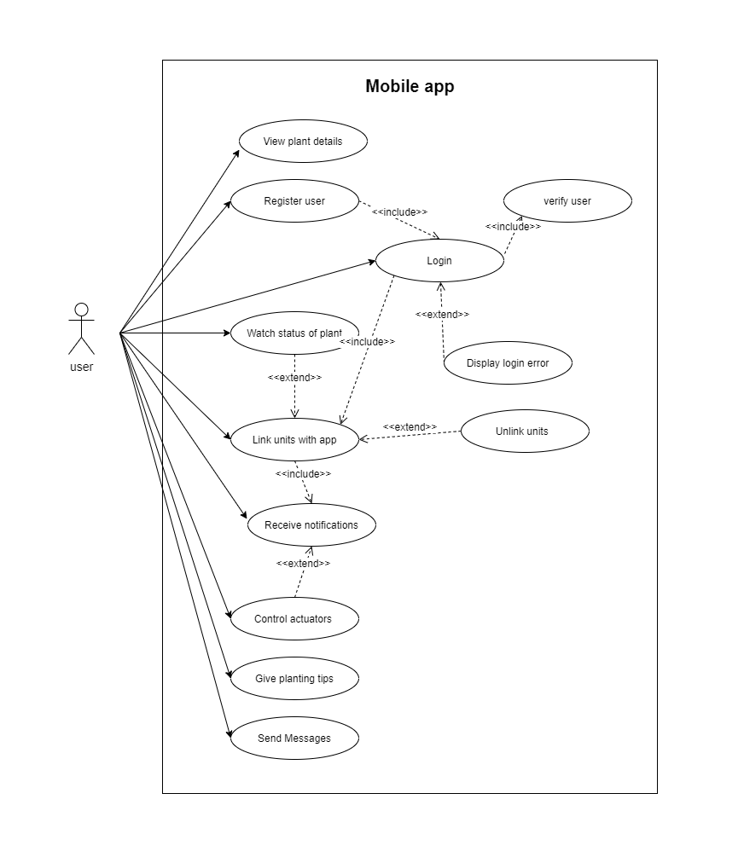
Mobile App
G27
Notes:
This is our Mobile App use case diagram.[Move to next slide ]
As you can see this is our mobile App use cases
we have one actor who is the user of mobile App
View plant details
register user
login user
watch status of plant
link units with app
chat module are some of our use cases

Slide 18
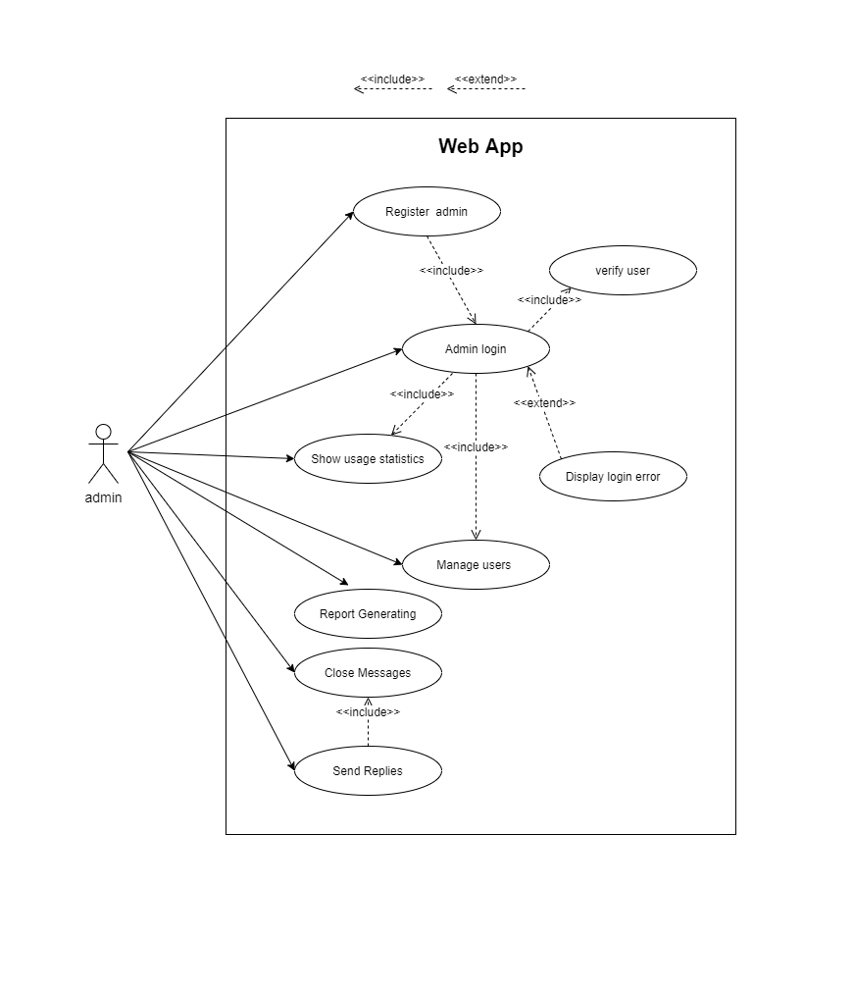
Web App
G27
Notes:
This is the use case diagram of our web App. [Move to next slide ]
here we have one actor who is the admin of web App
Register admin
login admin
show usage statistics
manage users
chat module are some of use cases

Slide 19
Green Core - The Smart Gardner
G27
Outline
Introduction
Problem Definition
Goal and Objectives
Project Scope
Deliverables
Functional Requirements
Quality Attributes
Feasibility Study
Progress of the project
Member Contribution
High Level System Architecture
Technologies
Deployment Plan
Notes:
from here onwards hasini will continue the presentation

Slide 20
Functional Requirements
G27
Notes:
Thank you Kavishka, Functional Requirements

Slide 21
Functional Requirements of the Mobile App
G27
User can sign up and log into the mobile App and setup account settings.
App is able to get feedback of IoT units.(Humidity sensor,Light intensity sensor,servo motors,water level sensor and soil moisture sensor )
Periodic notifications regarding status of the user’s garden.
User can monitor the garden status.(water level,nutrition level and light intensity)
User can add new units/modules
Users can contact administrators using the inbuilt chat .
Notes:
We have identify functional requirements of our mobile App as…..
User can sign up and log into the mobile App and setup account settings.
App is able to get feedback of iot units .Some of the sensors we are using are Humidity sensor,Light intensity sensor,servo motors,water level sensor and soil moisture sensor .
Periodic notifications regarding status of the user’s garden.
User can monitor the garden status like water level,nutrition level and light intensity.
User can add new units or modules.
And also users can contact administrators using the inbuilt chat.

Slide 22
Functional Requirements of the Web App
G27
User(admin) can sign up and log in.
User can update profile details.
View analyzed data(graphs) about gardens.
View a district wise local map of all the mobile app users garden location.
Notify about failed or vulnerable units.
Contact users regarding their issues and issues with their IOT devices(Chat Module).
Notes:
Here are the functional requirements in our web App
User,all admins can sign up and log in.
User can update their profile details.
View analyzed data(graphs) about gardens.
View a district wise local map of all the mobile app users garden location.
Notify about failed or vulnerable units.
Contact users regarding their issues and issues with their IoT devices thorough Chat Module in the web App.

Slide 23
Functional Requirements of the IoT Device
G27
Plant Watering System
Plant Fertilization system
Light Intensity Control
Notes:
Here are the functional requirements in our IoT Device
Plant Watering System
Plant Fertilization system
Light intensity Control

Slide 24
Quality attributes
G27
Notes:
Now we will consider about the quality attributes.

Slide 25
G27
Availability
System will be available on both mobile and web with any internet accessible device.
Usability
Simple and easy to use interface throughout the mobile and web App.
Dependability
Backups backend database to a database in the cloud
periodically.
Notes:
Availability
System will be available on both mobile and web with any internet accessible device.
Usability
Simple and easy to use interface throughout the Mobile and Web App.
Dependability
Backups backend database to a database in the cloud periodically.

Slide 26
G27
Security
Only administrators can access the web App and
Only registered users can enter to the mobile app.
Assumption- Administrator is a trustworthy person.
Maintainability
Mobile app can be updated easily through Playstore.
Repairs on the IoT device can be done easily because of the modular nature of the IOT device.
Notes:
Security
Only administrators can access the web App and
only registered users can enter to the mobile App.
In here we assume as , administrator is a trustworthy person.
Maintainability
Mobile app can be updated easily through Playstore.
Repairs on the IoT device can be done easily because of the modular nature of the IOT device.

Slide 27
Green Core - The Smart Gardner
G27
Outline
Introduction
Problem Definition
Goal and Objectives
Project Scope
Deliverables
Functional Requirements
Quality Attributes
Feasibility Study
Proposed Technologies
Project Delivery Timeline
High Level System Architecture
System Development Methodology
Notes:
from here onwards Minura will continue the presentation.

Slide 28
Green Core - The Smart Gardner
G27
Outline
Introduction
Problem Definition
Goal and Objectives
Project Scope
Deliverables
Functional Requirements
Quality Attributes
Feasibility Study
Progress of the project
Member Contribution
High Level System Architecture
Technologies
Deployment Plan
Notes:
from here onwards Minura will continue the presentation.

Slide 29
Feasibility Study
G27
Notes:
Feasibility study that we have conducted for our project

Slide 30
Technical Feasibility
G27
To satisfy our requirements, IoT device ESP8266 and arduino mega is sufficient along with some sensors such as soil moisture, humidity, etc.
We use Amazon Web Server(AWS) which is also available for free for a year to host our virtual servers.
MongoDB , Node.js and Reactjs are Free and Open Source.
Mobile App will run on any tablet or smartphone with proper backups.
Web App will run on all major browsers with proper security features.
Notes:
for the first step
The mentioned ioT device and the arduino mega is sufficient to satisfy requirements.
Virtual servers will be hosted by amazon web server.
All technologies that we use Mongodb, node js and react js are free and open source and
Both the mobile app and the web app will run on any smart device with proper backup and security features.

Slide 31
Operational Feasibility
G27
Both the mobile App and web App will provide simple and intuitive Interfaces to the user.
Web based System so that user can enroll with the system at any time any where.
Almost everyone uses smartphones in their daytoday life so an app is a good way to get notifications about the plantation.
Notes:
Both mobile and web Apps will have simple interfaces which will be easy to use.
Also any user will be able to use the web app anytime anywhere.
since everyone use smart devices nowadays, users can get notifications about their plants easily

Slide 32
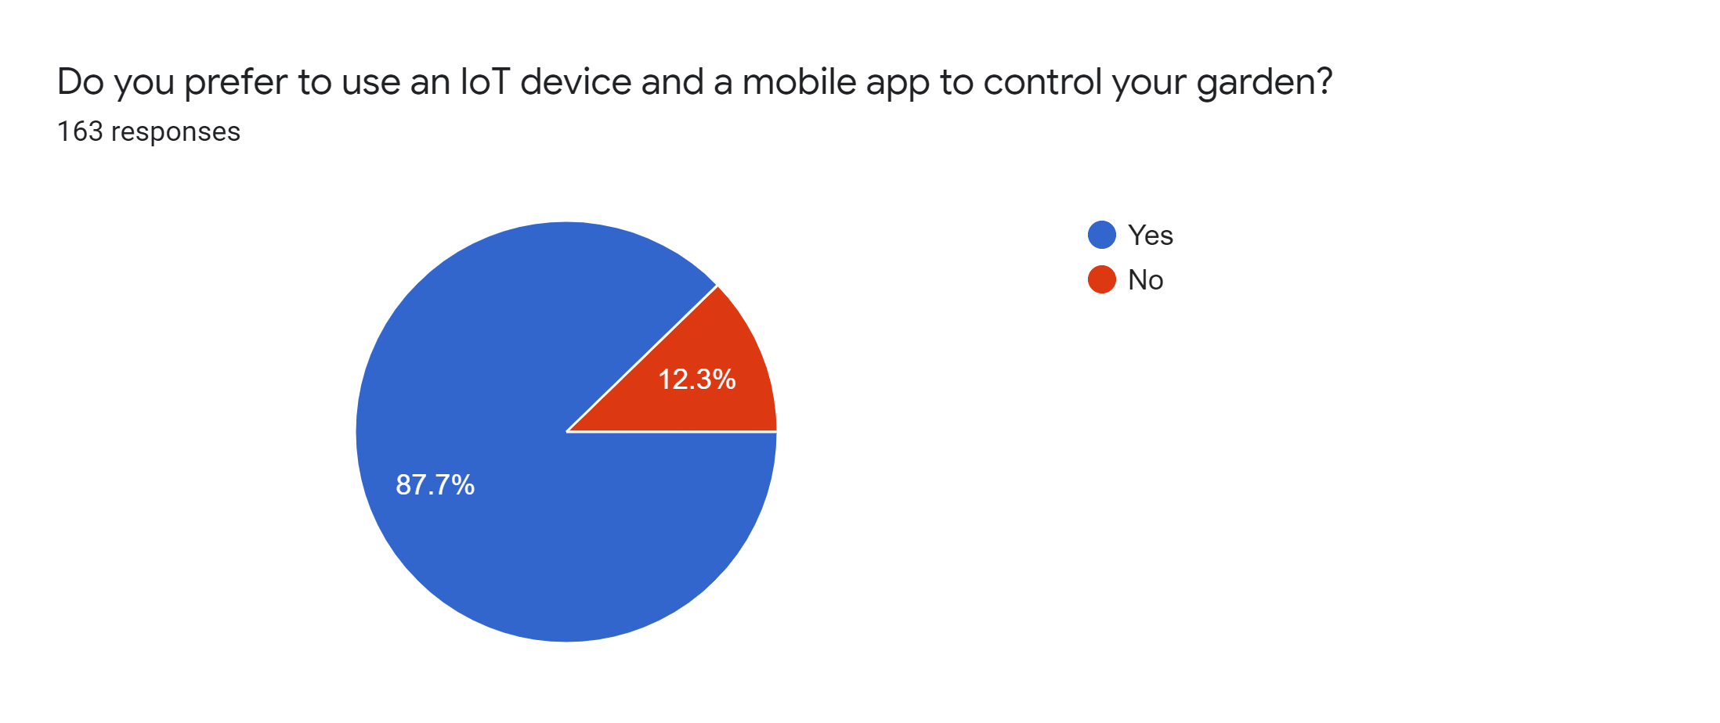
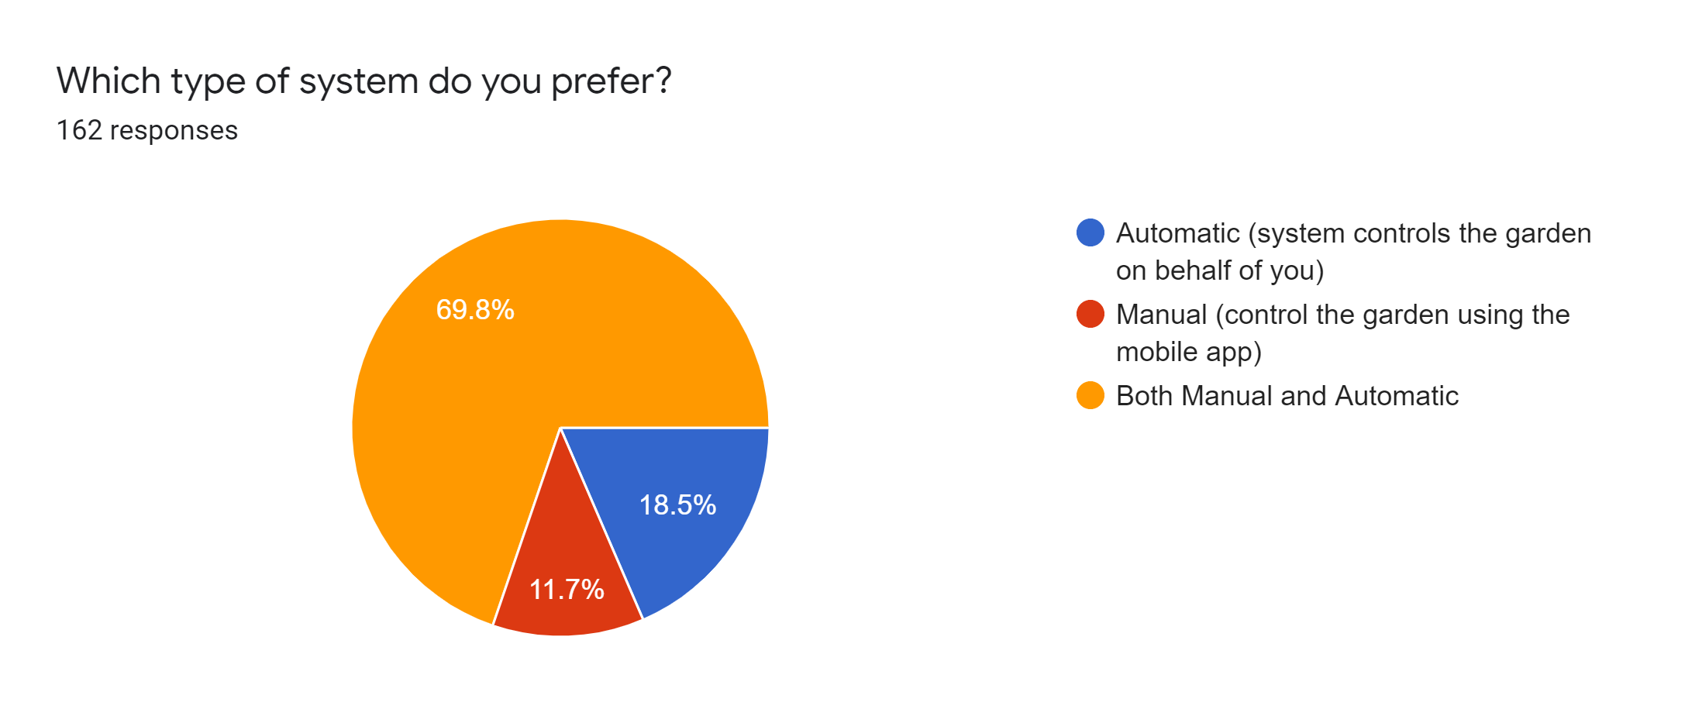
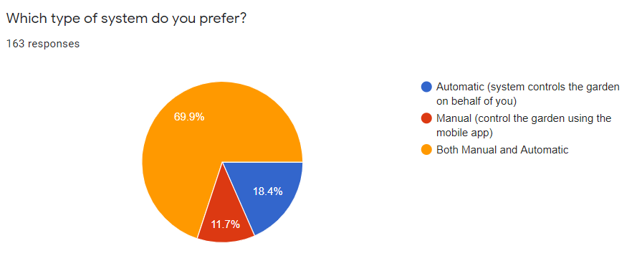
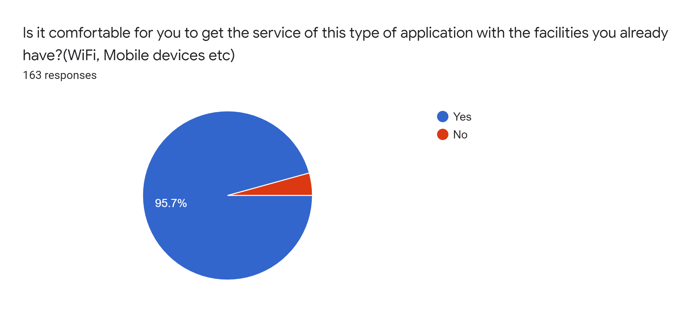
G27
Notes:
These are some survey results

Slide 33
Economic Feasibility
G27
The web App is hosted in the AWS free-tier server, which is provided by AWS for free for one year and this bears zero cost for the first year of operation.
As we use MongoDB for our database which is free and there are 25 Million database operations provided for the free tier.
We develop IoT device using arduino uno and ESP8266 as they are cost effective (cost will be around 20$ per unit)
Since it is developed only by a team of university students, development cost also can be factored as none.
Notes:
. Our web app is hosted in the Amazon WS server which is free for 1 year
all the other technologies we use are free and open source (mongodb, react js )
. The only cost will be for the ioT device which will cost around $20 per unit
As this system is developed by us development cost also can be considered as none.

Slide 34
Schedule Feasibility (Time Estimation )
G27
Number of work hours for a member
○ Weekdays = 3*5
○ Weekends = 4*2
● Man-hours per week = (3*5 + 4*2 )*6= 138
Estimated number of weeks = 13
Estimated total of man hours = 138*13 = 1794
Notes:
As estimated this project will take 13 weeks to complete.
So as mentioned all the team member s will work according to the schedule to complete the project within the allocated time

Slide 35
Legal and Ethical Feasibility
G27
Privacy of information -​ User details and their garden information will not be exposed at any cost.
Handling user data -​ The interest of the user within the system is confidential and will not be sold or used for advertising purposes (AdSense etc.)
User and IoT device location will be recorded only with the consent of the user.
Notes:
for the final step
The private info of the users will be protected.
And User data will not exposed to a third party for any other purposes. Like advertising
And also User have to give the approval for the app to track their location.
Therefore we have decided that this project GreenCore is feasible for all categories above mentioned.
Binara will conduct the rest

Slide 36
Green Core - The Smart Gardner
G27
Outline
Introduction
Problem Definition
Goal and Objectives
Project Scope
Deliverables
Functional Requirements
Quality Attributes
Feasibility Study
Progress of the project
Member Contribution
High Level System Architecture
Technologies
Deployment Plan
Notes:
from here onwards Binara will continue the presentation.

Slide 37
Progress of the project
G27
Notes:
Progress of the project

Slide 38
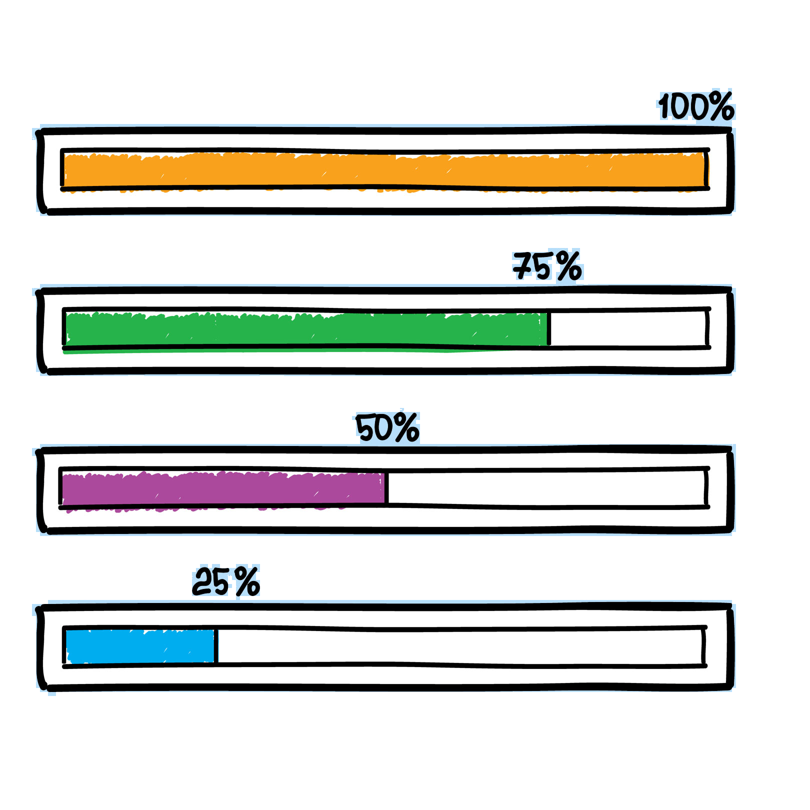
Mobile App
G27
Completed Tasks
View User profile
Registration
Update User Details
Login
Link Units
Chat Module
Navigation
View All Units
Ongoing Tasks
Forgot Password
View Unit Details
Email Verification
Alerts
Remaining Tasks
Control Actuators
Notes:
Our main deliverables are the Mobile app and the IoT device. We have almost completed User Management including Login & Registration, Link Units, Chat Module and Unit Management in the mobile app
Currently we are working on the Forgot password, Email Verification, View Unit Details and Notifications(Alerts)

Slide 39
Web App
G27
Completed Tasks
Chat Module
View All Users
View All Units
View Single Unit
Navigation
Ongoing Tasks
Registration
Login
View Admin Details
Update Admin Details
View Single User
Remaining Tasks
View All Vulnerable Units
Unit Location View
View Single Vulnerable Unit
Email Verification
Forgot Password
Reset Password
Notes:
In the web app we have completed the chat module, View All Users, Units and Navigation.
Login and Registration, admin User management are under development

Slide 40
IoT Device
G27
Completed Tasks
Soil moisture detection
Humidity detection
Temperature detection
Light Intensity Control
Ongoing Tasks
Plant watering system
Lighting System
Remaining Tasks
Fertilizing system
Notes:
In the IoT Device we have completed Soil moisture detection Humidity detection Temperature detection and Light Intensity control.
Currently we are working on the Plant watering system and the lighting system

Slide 41
Design & Documentation
System & Database Design - 100%
Software Requirement Specification - 100%
User Manual - Not Yet Started
Notes:
When it comes to Design and Documentation we have already completed the System & Database design and the SRS

Slide 42
Member Contribution
G27
Notes:
All the 6 members contributed to the project in both development and documentation

Slide 43
G27
M.M.H Tharushika - 17001765 | Web App User Registration User Login
H.U.K.M Pabasara - 17020611 | Web App View Users View all Vulnerable Units
Notes:
Hasini worked and minura worked on the User Management of the Web App

Slide 44
J.A.N.C Niroshana - 17001196 | Mobile App Account settings Profile settings Link units Linked units Unit details Notifications(Currently developing)
Notes:
Nipuna worked on Unit management, Notifications and Account Settings of the mobile app

Slide 45
G27
B.A Medawatta | Chat Module - Web App View All Messages View Single Message Reply Message View Unread Messages Chat Module - Mobile App Send Message Reply Message View All Messages View Single Message Navigation - Web App Sensor detection & Control - IoT Device
Notes:
Me, Binara worked on the Chat module of both Web app and the mobile app and
sensor detection and control of the IoT Device

Slide 46
G27
K.C Gamage - 17000475 | Mobile App Splash Screen Log in and Log out Secure Mobile App all Rest API requests with JWT tokens Sign up Mobile App Navigation
K.S.A Ahamed - 17020034 | Web App View units View users
Notes:
Kavishka worked on the login, registration and navigation of the mobile app
Athil worked on the View Units and View Users of the web app

Slide 47
Green Core - The Smart Gardner
G27
Outline
Introduction
Problem Definition
Goal and Objectives
Project Scope
Deliverables
Functional Requirements
Quality Attributes
Feasibility Study
Progress of the project
Member Contribution
High Level System Architecture
Technologies
Deployment Plan
Notes:
from here onwards Nipuna will continue the presentation.

Slide 48
High Level System Architecture
G27
Notes:
Thank you Binara. Next we’ll move into the High level system Architecture

Slide 49



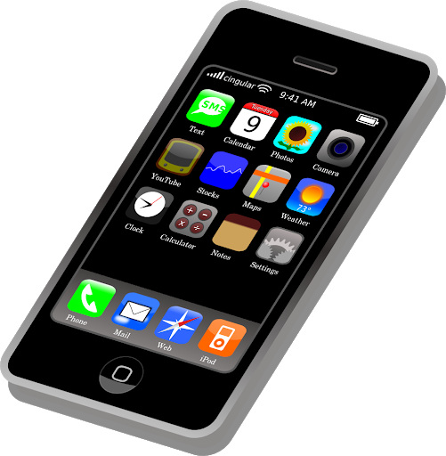
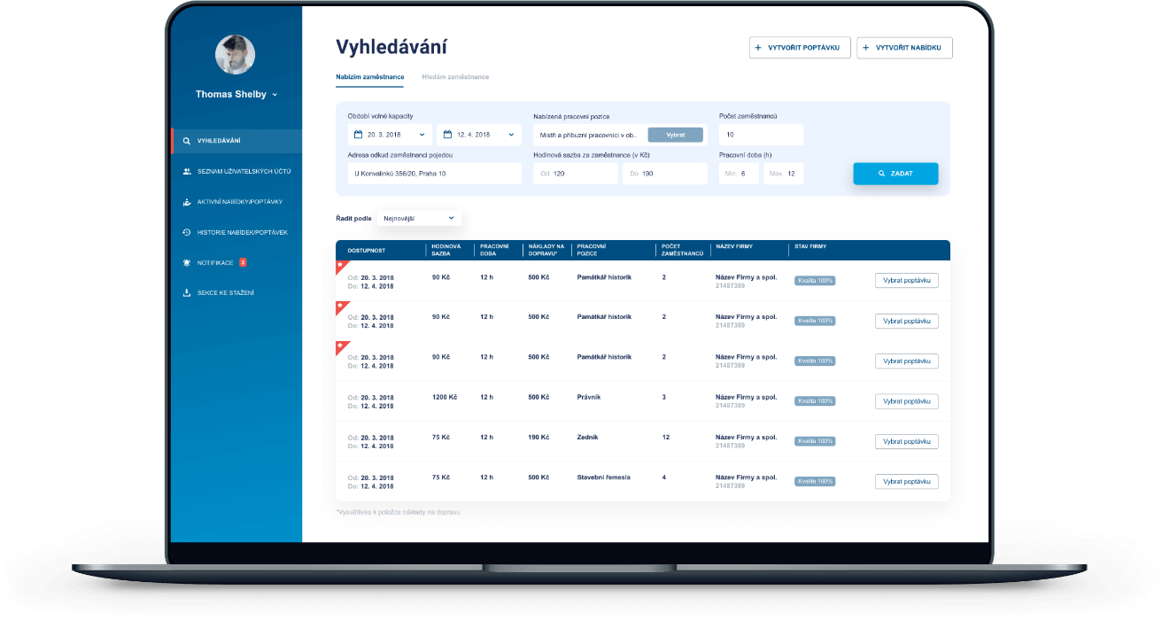
G27
Database
Web server
Web server
Web server
IoT device
Web app
Mobile app
Notes:
Our system consists of a central database which the mobile app, web app and the iot device will be connected using independent servers.
Communication between the apps, devices and the servers are done VIA API calls.
The IoT Device will collect data from the sensors and pass it to the database. The web app and the mobile app can retrieve data from the database. All the functions carried out by the
user with the IoT device will be first updated in the database and then the action will be carried out in the IoT device.

Slide 50
Technologies
G27
Notes:
Next we’ll move into technologies

Slide 51
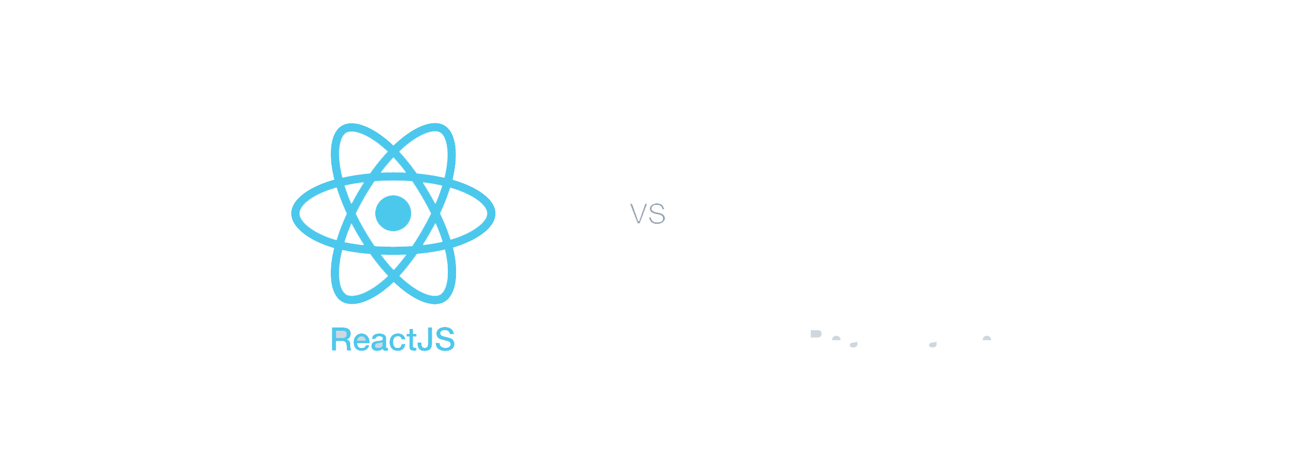
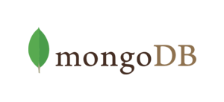

Mobile App & Web App
Front End
Back End
React JS
MongoDB
React native
NodeJS
Notes:
We use ReactJS for the front end of the web app and react native for the mobile app. As the backend server, we are using nodejs and MongoDB as our database

Slide 52
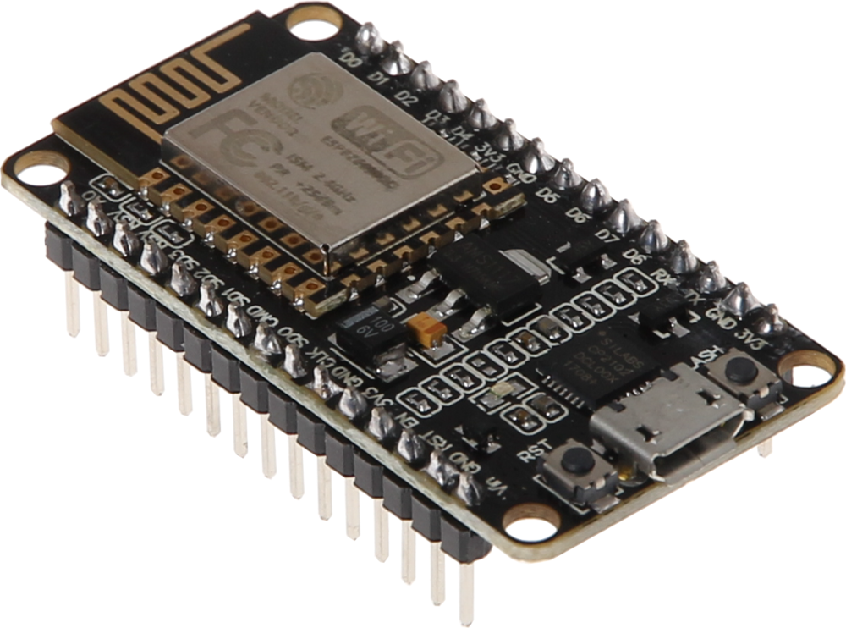

IoT device
Device
Back End
Node MCU
MongoDB
Arduino mega
NodeJS
Notes:
For the IoT Device, we use Arduino to collect sensor data and to control actuators
and a NodeMCU for communication.
For the backend development of the IoT Device, we use Node.js as the server and MongoDB as the database
//For the backend development of the IoT Device, we use Node.js and the same MongoDB database as the database

Slide 53
Deployment Plan
G27
Notes:
Deployment Plan

Slide 54


Deployment Plan
G27
Testing and deployment will be initially done in a Heroku server
When the user base grows the servers will be deployed in AWS EC2 instances.
Notes:
Currently we have hosted the backend of our Mobile App in a heroku server for testing
and the other two backends will also be hosted in heroku servers for testing.
In the Later on the deployment will also be done in heroku servers.
As the user base grows we are planning to shift the servers to a AWS EC2 instance

Slide 55
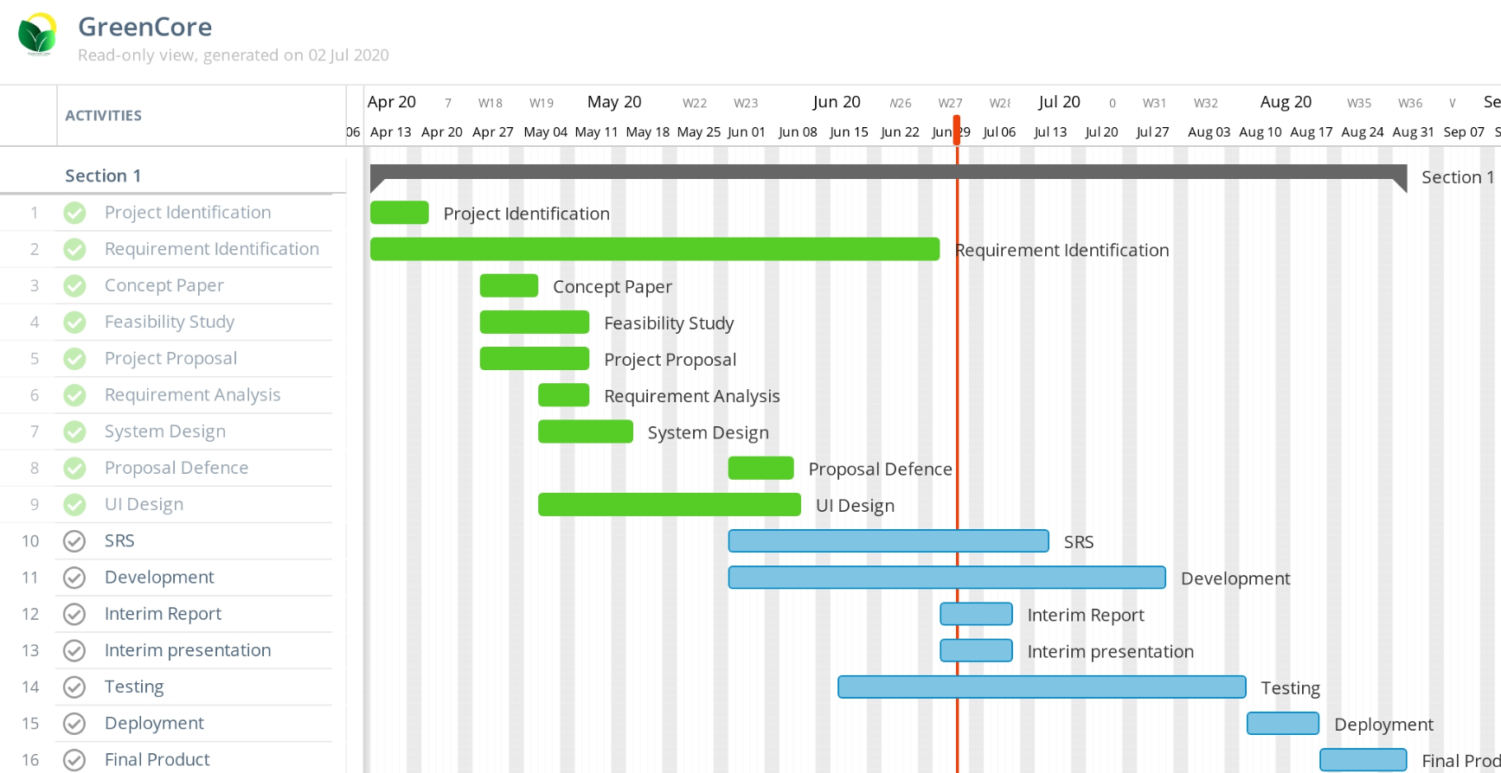
Project Delivery Timeline
G27
Notes:
We have planned to complete the project by the end of August 2nd week
And currently we have completed the System Design including the System Requirement Specification
and currently we are in the development stage
Since we are practicing agile Testing is done along with the development.
By now we have only executed unit tests.
And finally we have planned to deploy our system by the end of August.

Slide 56
System Development Methodology & Project Management
G27

Slide 57

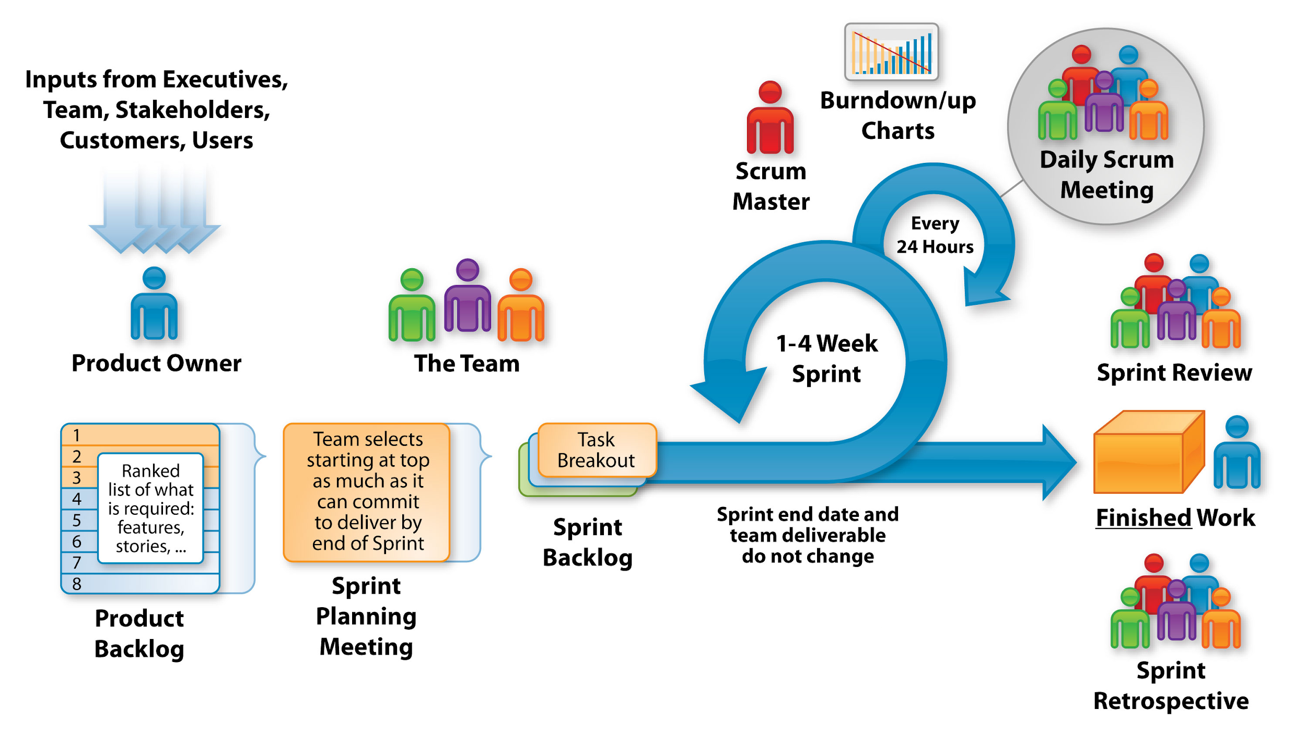
G27
Notes:
We are developing the system according to agile scrum methodology and currently we are in the 6th sprint
// We are developing the system according to agile scrum methodology and we work on one week sprints, which includes development work of both the mobile app and the web app. Since we are working on both the web and mobile app at the same time, we have two separate backlogs for each. We are having daily standup meetings via a whatsapp group and by the end of the sprint we are having a sprint review, retrospective ( ret ros pec tive ) and a sprint planning meeting. and currently we are in our 6 th sprint
We selected scrum because,
our system has changing requirements
Active team and client interaction is needed
We’re a cross functional team
Since the team is working remotely it’s easy to manage the backlog and track individual progress

Slide 58
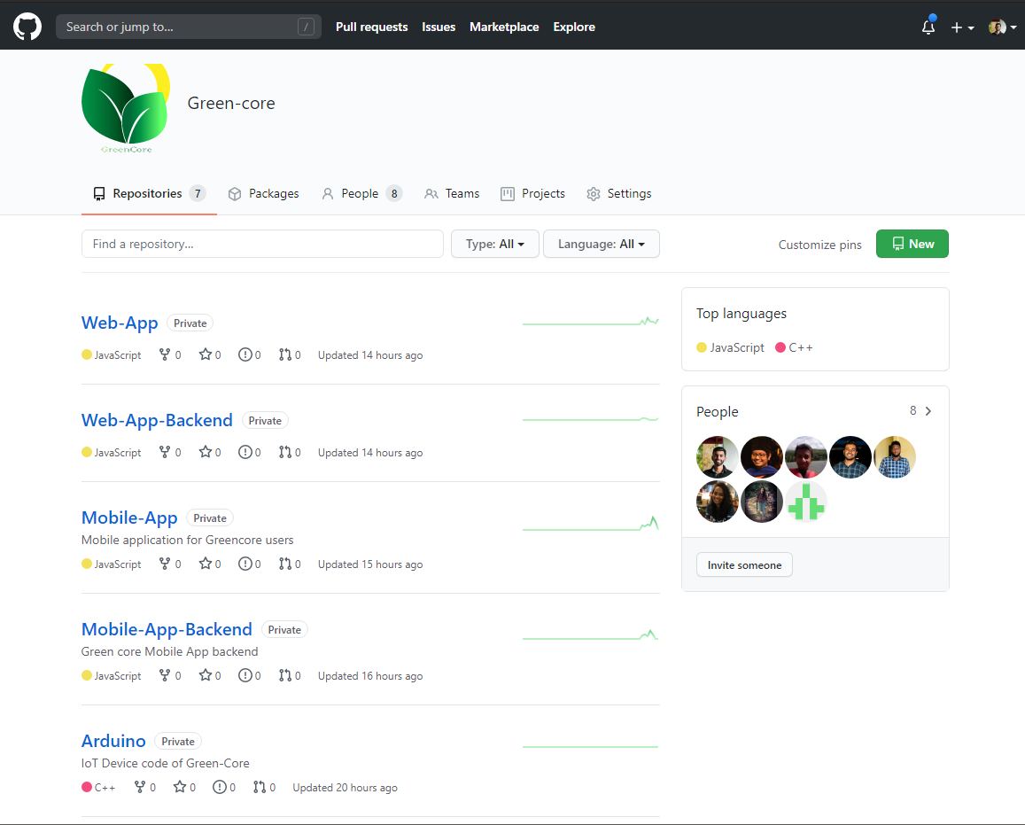

Notes:
// and we are using github for version controlling
We are using GitHub for version controlling and we have created a private organization in GitHub to manage our repositories
By now we have 7 repositories, one for documents, two for the mobile app, two for web app and other two for the IoT Device

Slide 59

Thank You
G27
Notes:
Thank you

Slide 60
Demonstration
G27
Notes:
let’s move on to the demonstration

Slide 61
Any Questions ?
G27
Notes:
Thank you, we are happy to take any questions.

